Slide 1


OPEN SOURCE PLASTIC
RECYCLING MACHINE
Mardi 7 décembre
Notes:
WILLIE

Slide 2




Table of contents
1 - Meeting with Germain LEMASSON: Wednesday 24th of November
2 - Updated Gantt
3 - Improvement of the shredder
4 - Press research phase
5 - Organisation of the routing of plastic
Notes:
WILLI

Slide 3
Table of contents
1 - Meeting with Germain LEMASSON: Wednesday 24th of
November
Notes:
MARGAUX

Slide 4

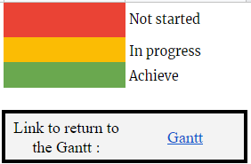
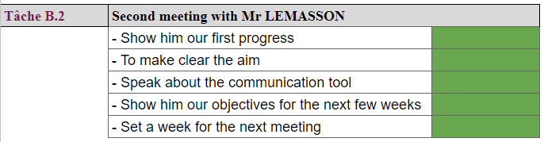
Meeting with the client
Notes:
MARGAUX

Slide 5
Table of contents
1 - Meeting with Germain LEMASSON: Wednesday 24th of November
2 - Updated Gantt
Notes:
MARGAUX

Slide 6
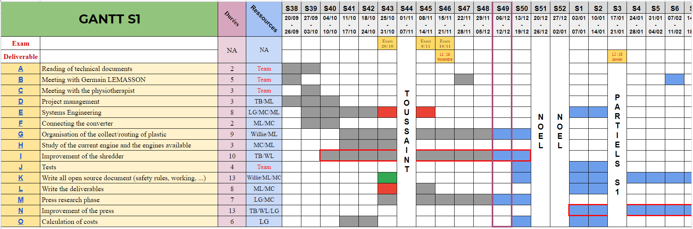
Updated Gantt
Notes:
MARGAUX

Slide 7
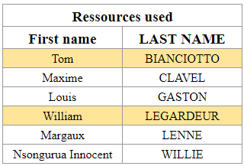
Table of contents
1 - Meeting with Germain LEMASSON: Wednesday 24th of November
2 - Updated Gantt
3 - Improvement of the shredder
Notes:
WILLIAM

Slide 8
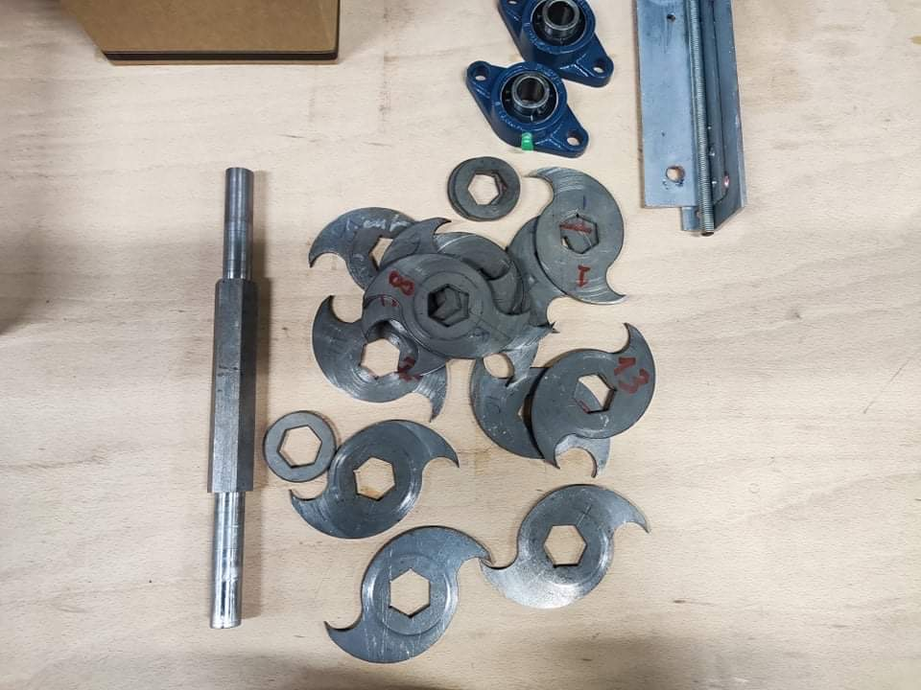
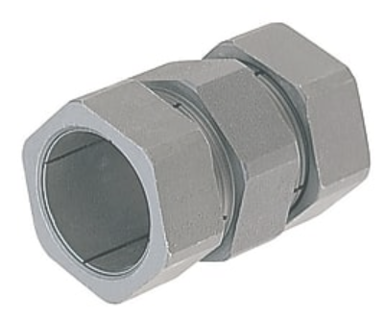

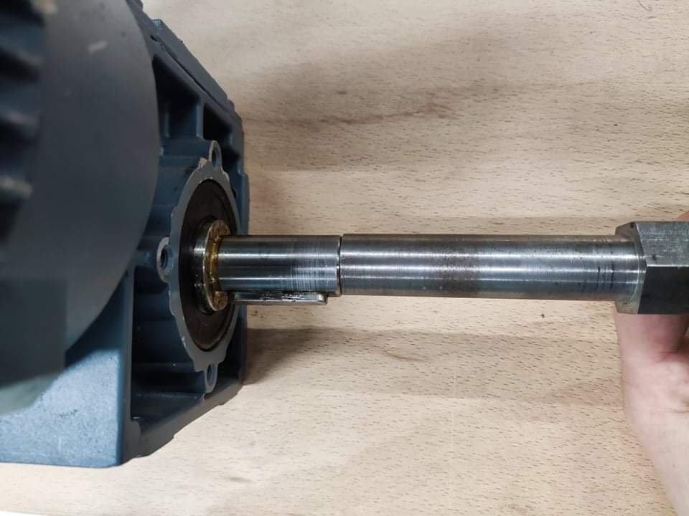
Shredder disassembly
disassembly for taking measures
studying of coupling solutions
Rigid
Flexible
Notes:
MAXIME

Slide 9
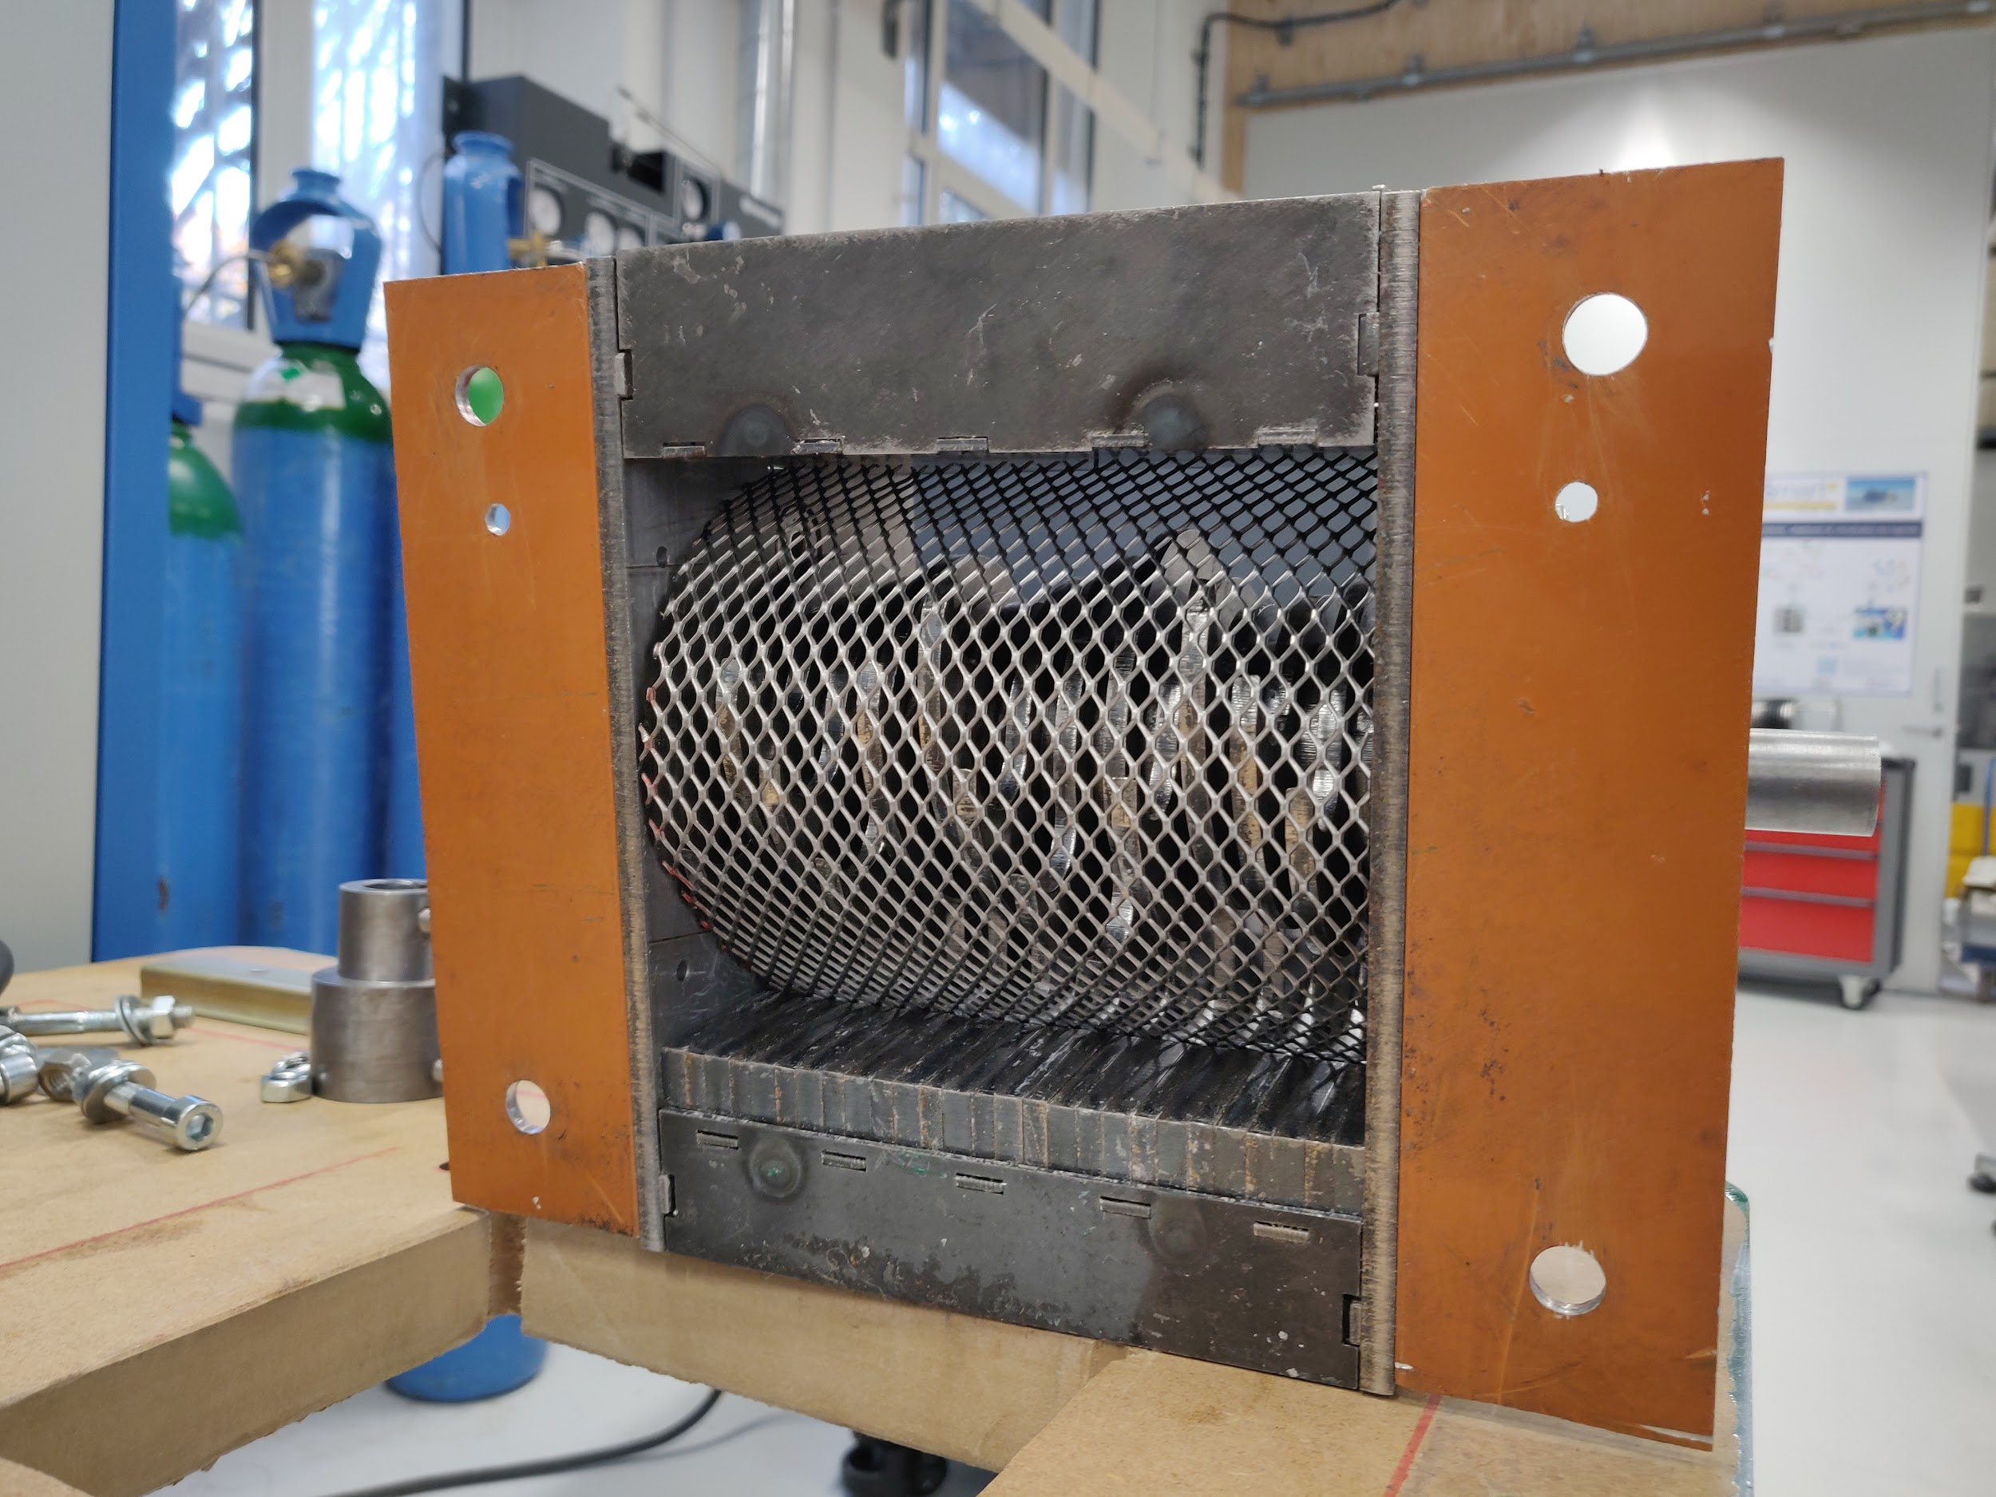
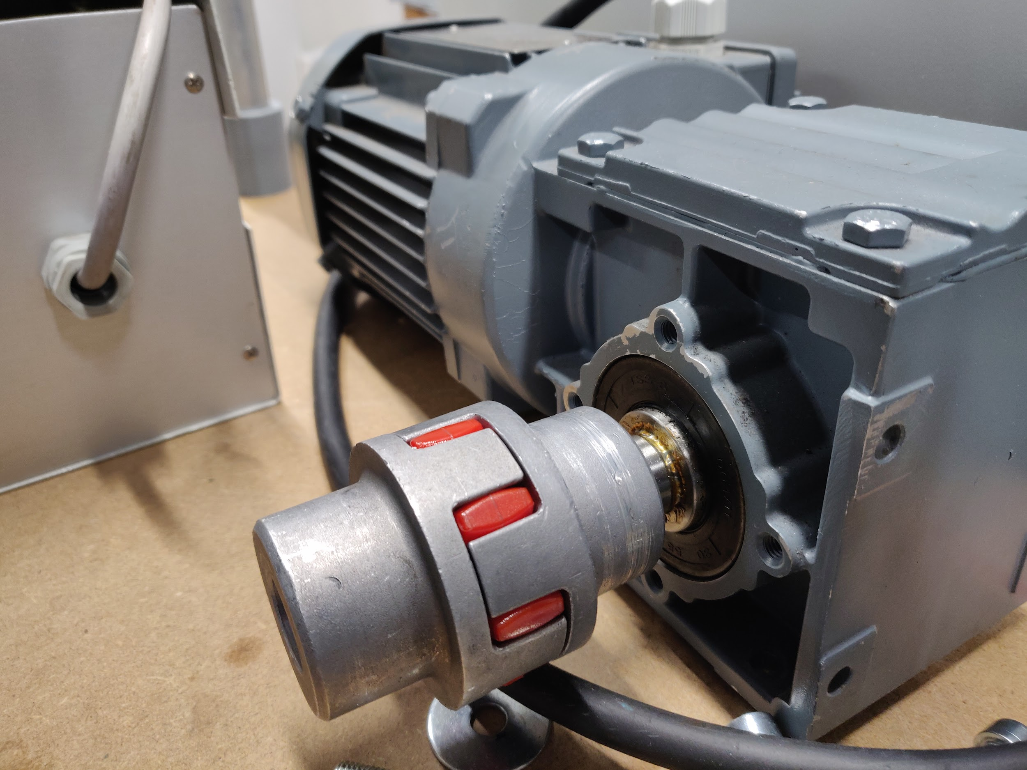
Shredder improvement
Notes:
MAXIME

Slide 10
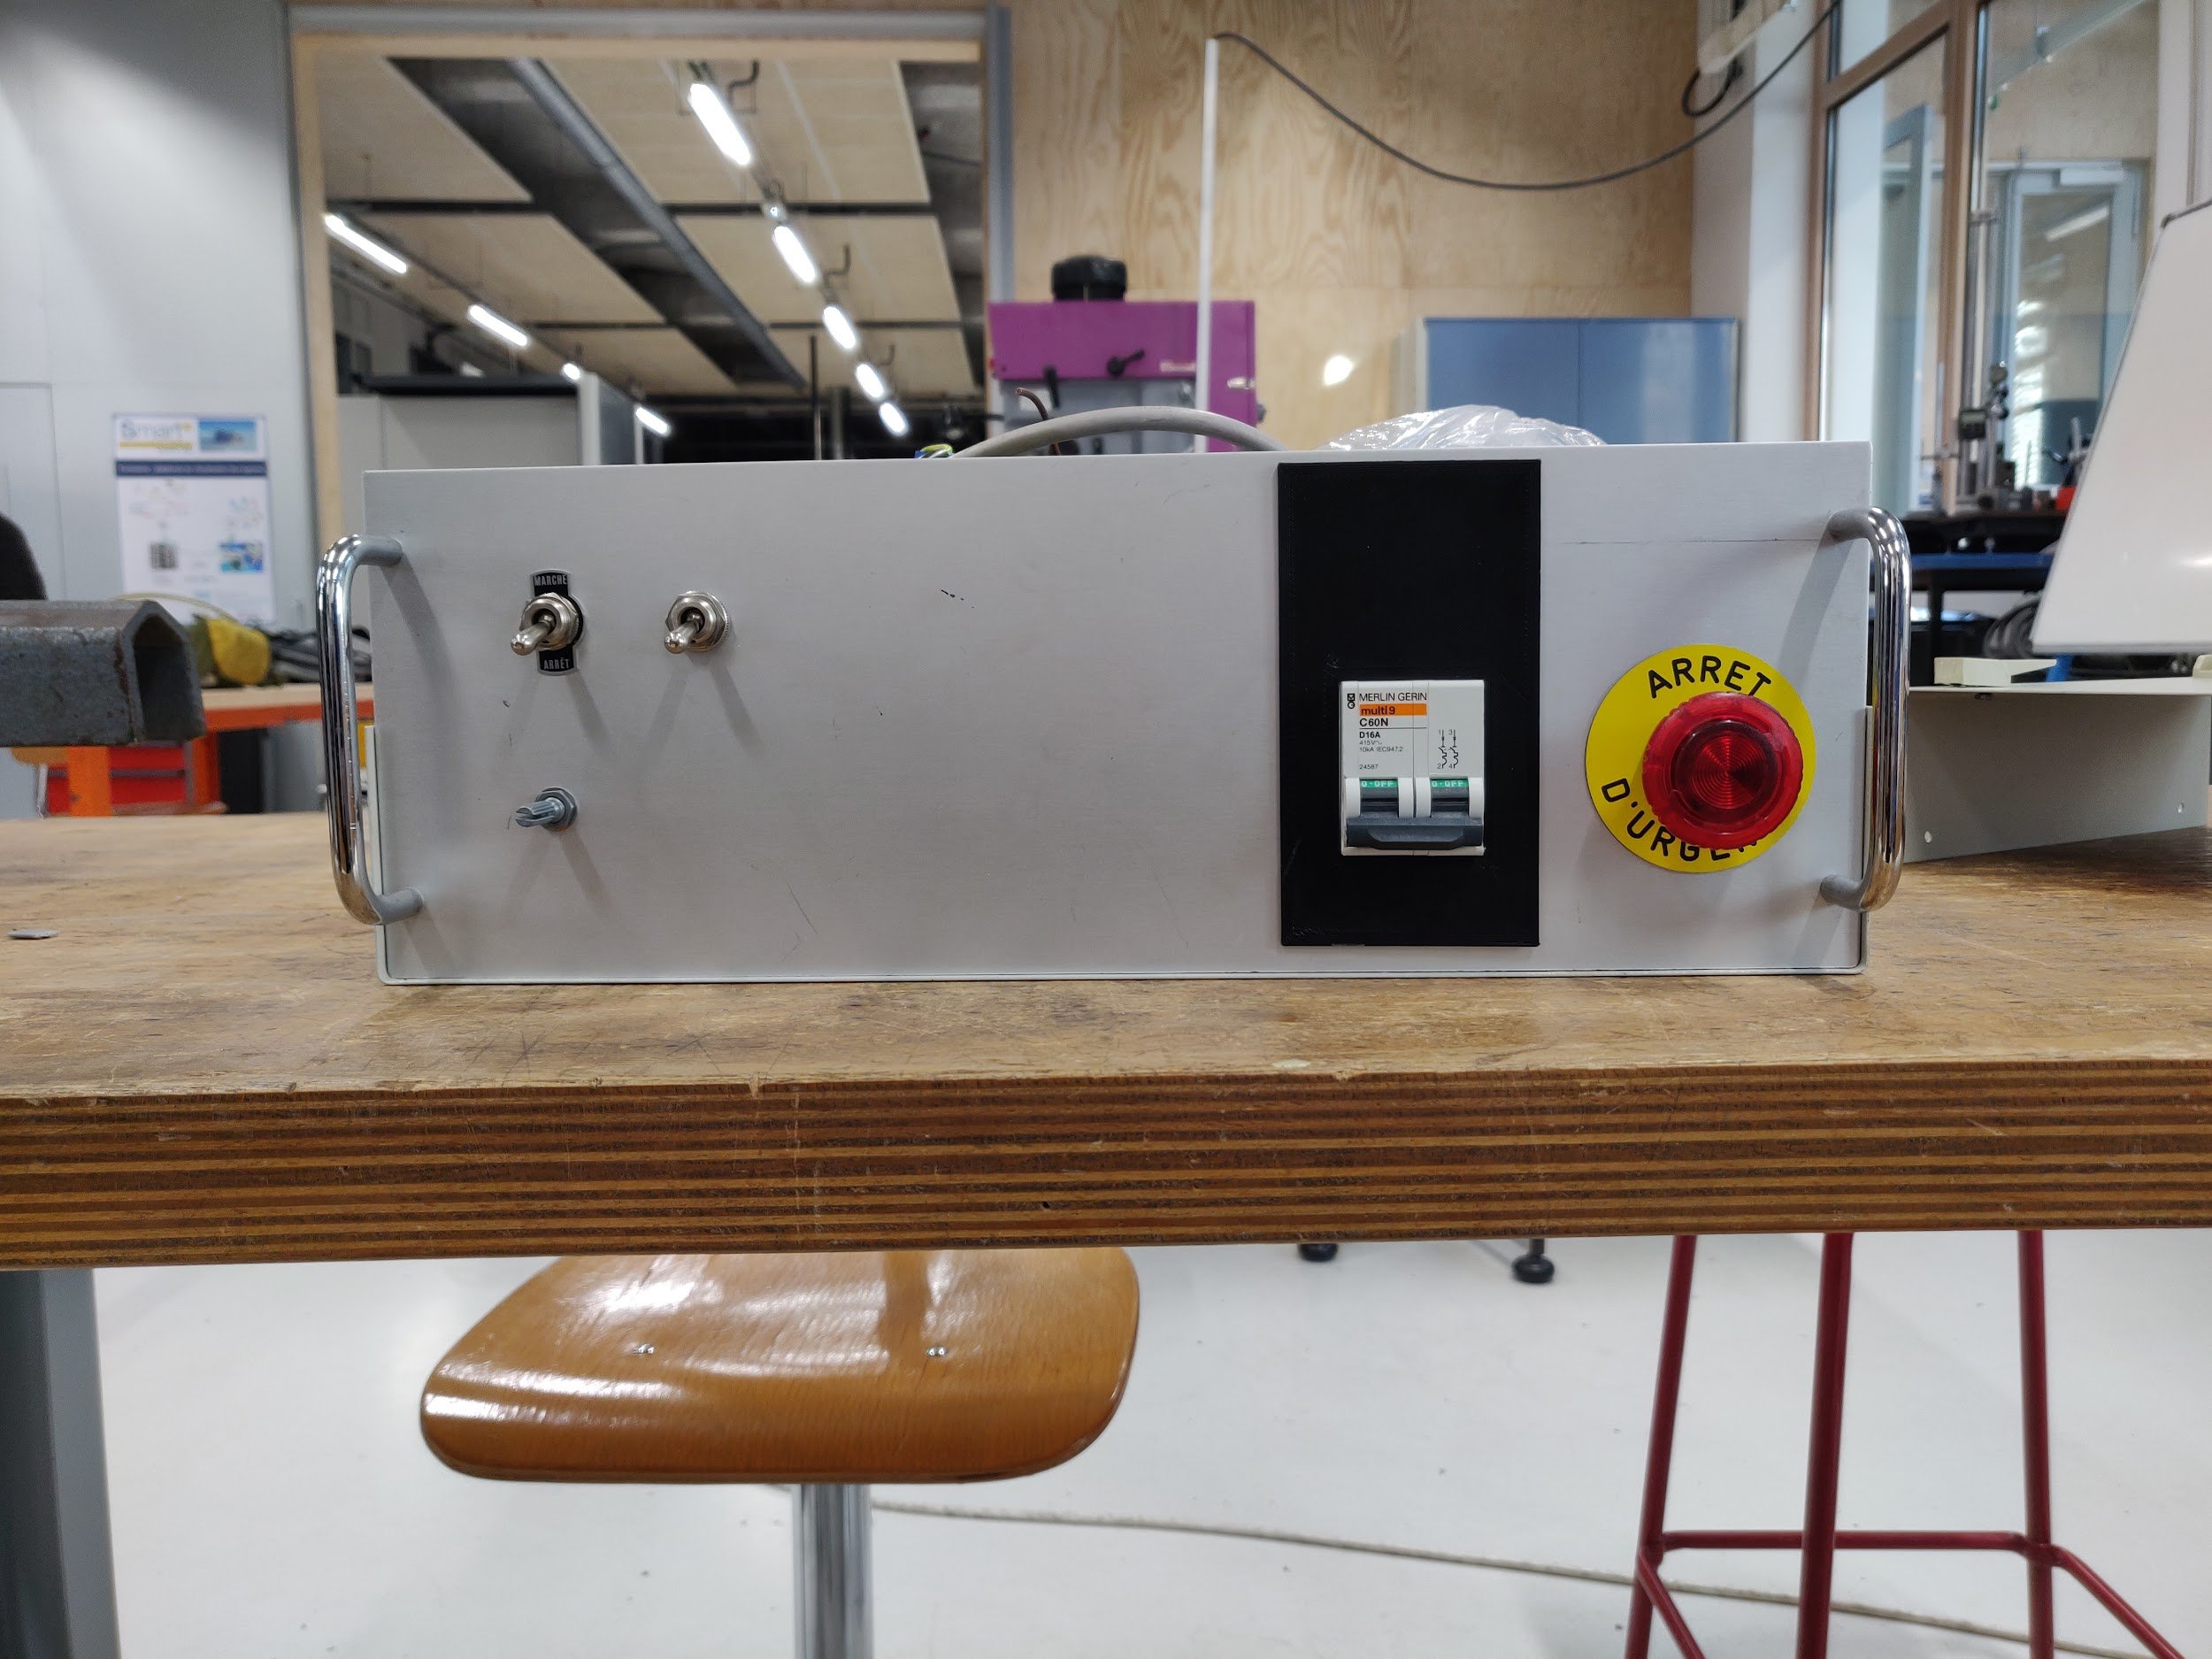
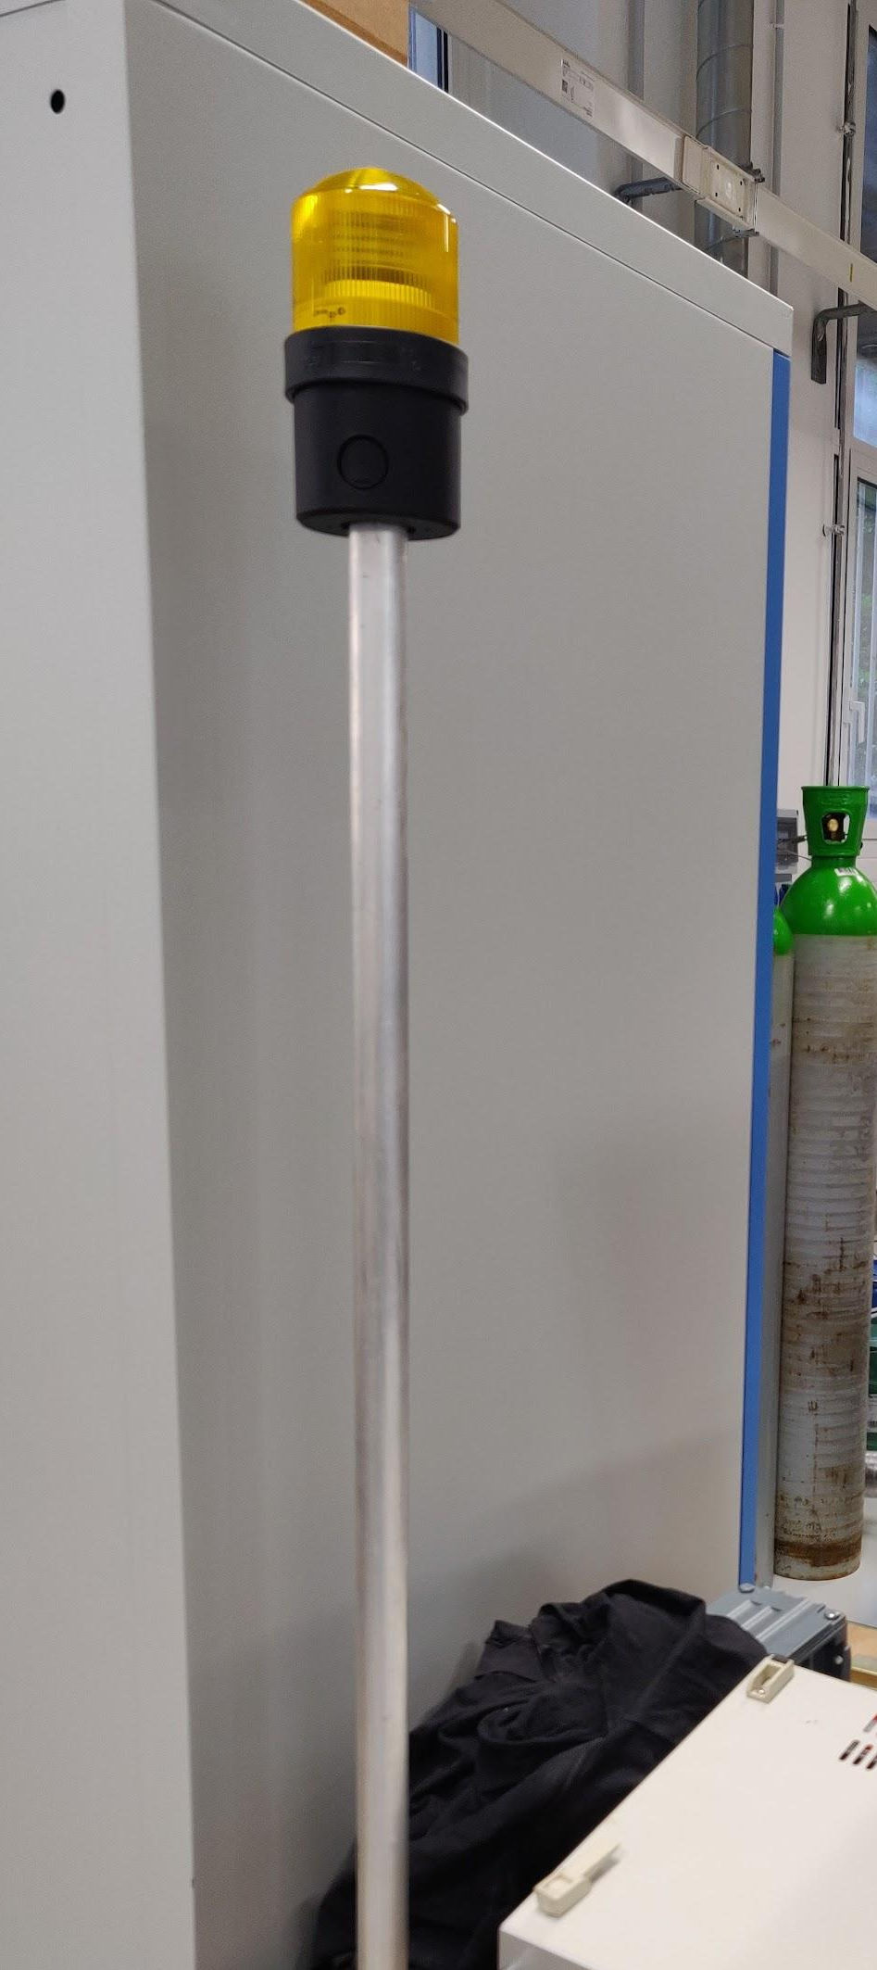
Shredder improvement
Notes:
MAXIME

Slide 11
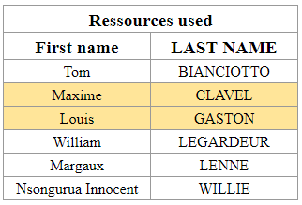
Table of contents
1 - Meeting with Germain LEMASSON: Wednesday 24th of November
2 - Updated Gantt
3 - Improvement of the shredder
4 - Press research phase
Notes:
WILLIAM

Slide 12
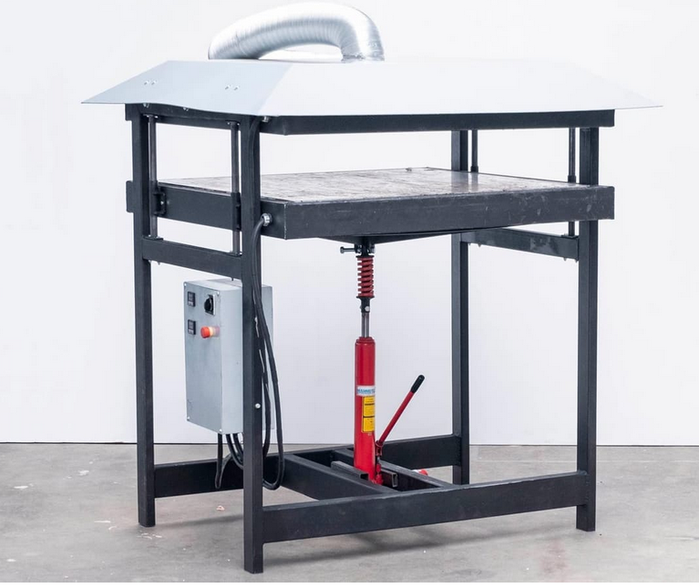
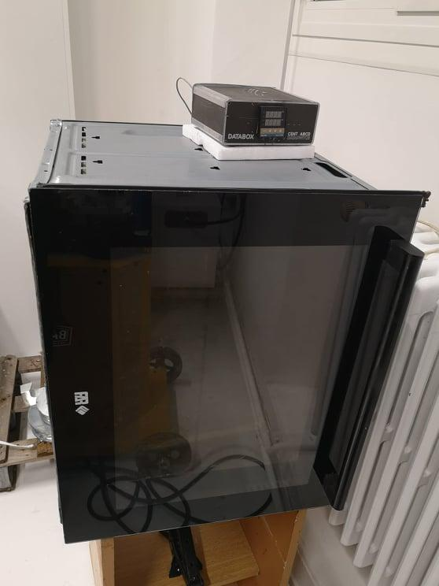
Press research phase
Open press
Our actual prototype
Open
Heated plates
Bigger Plates
Fumes to handle
Closed
Heated Atmosphere
Limited by the size of the chamber
Fumes controlled
Notes:
Someone else

Slide 13
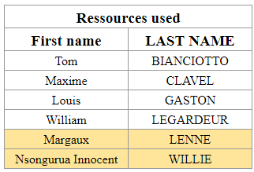
Table of contents
1 - Meeting with Germain LEMASSON: Wednesday 24th of November
2 - Updated Gantt
3 - Improvement of the shredder
4 - Press research phase
5 - Organisation of the routing of plastic
and open source
Notes:
WILLI

Slide 14

Organisation of the routing of plastic
A google sheet to manage stocks of plastic chips ?
2 solutions :
The customer who enters in the google sheet his need of plastic chips + quantity + type of plastic
We report in the google sheet when we have shredded plastic + quantity + type of plastic and the customer 'orders'.
Notes:
WILLIE

Slide 15

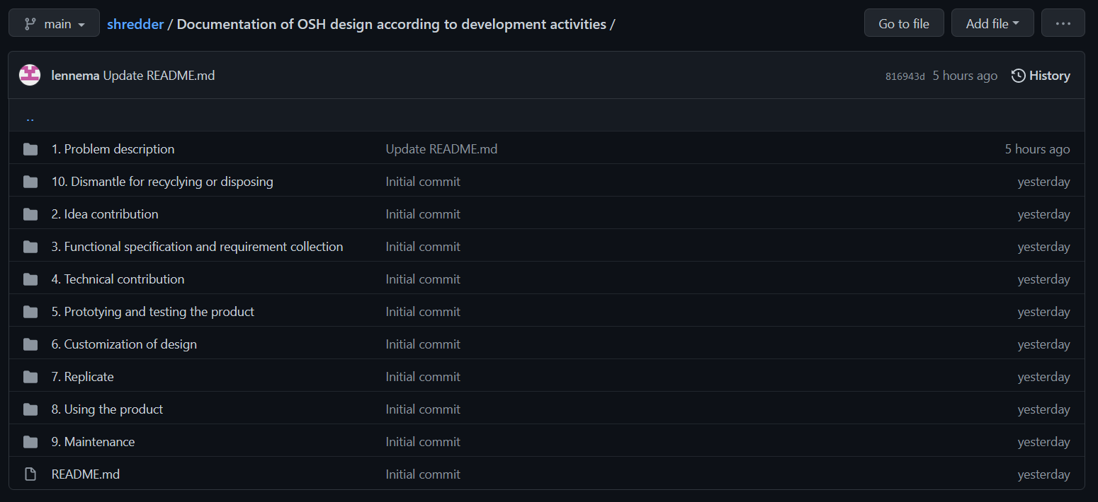
Sharing the open source documents
screen github
Notes:
WILLIE

Slide 16
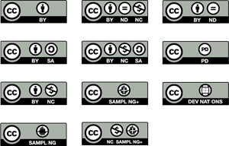

Sharing the open source documents
Notes:
WILLIE

